Slide 1
The Terminal
Matt Schneider

Slide 2

Question Everything
pwd
ls
whoami
hostname
man
whatis
Print working directory
List files
Current user
Current Host
Manual for command
Brief description of command

Slide 3
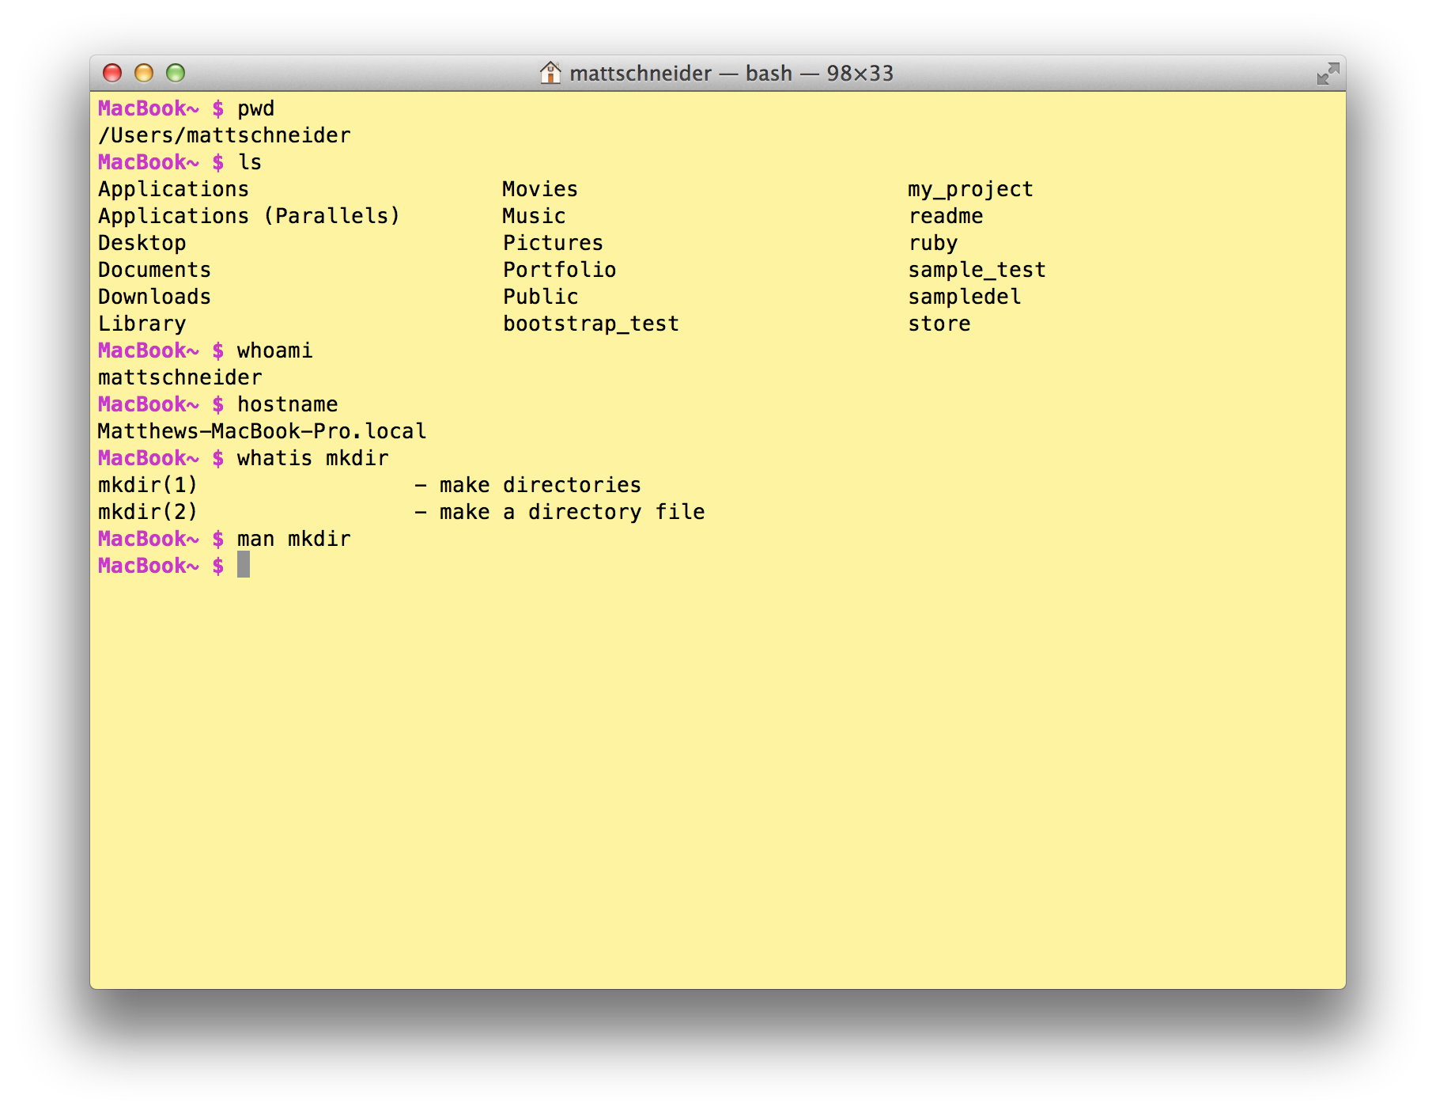

Slide 4

Do stuff
mkdir
cd
cp
mv
rm
clear
Make directory
Change directory
Copy
Move
Delete(remove)
Clear screen
Open file

Slide 5
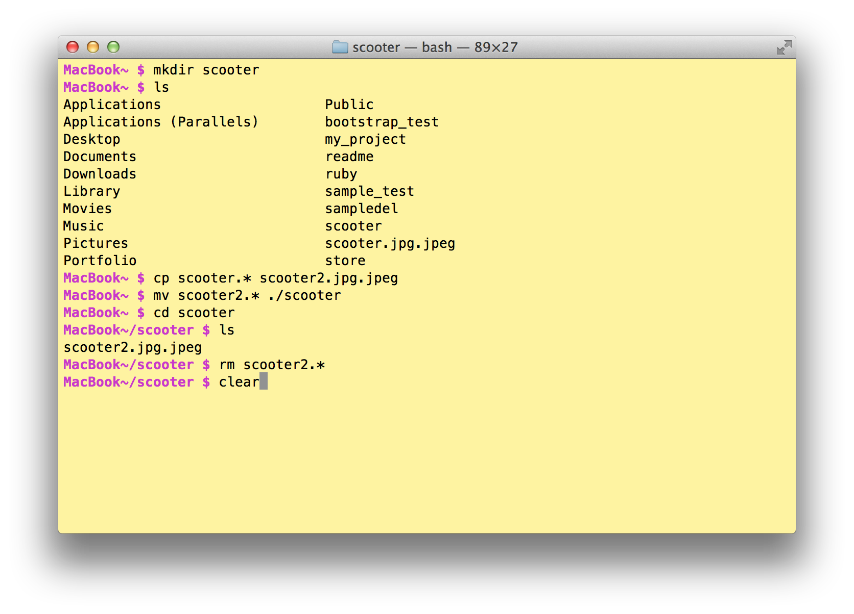

Slide 6

Misc.
open
ps
top
Ctrl-C
[space]
pico
Opens file
process status
shows all processes running
Exit command during execution
pages down
open text file for editing

Slide 7
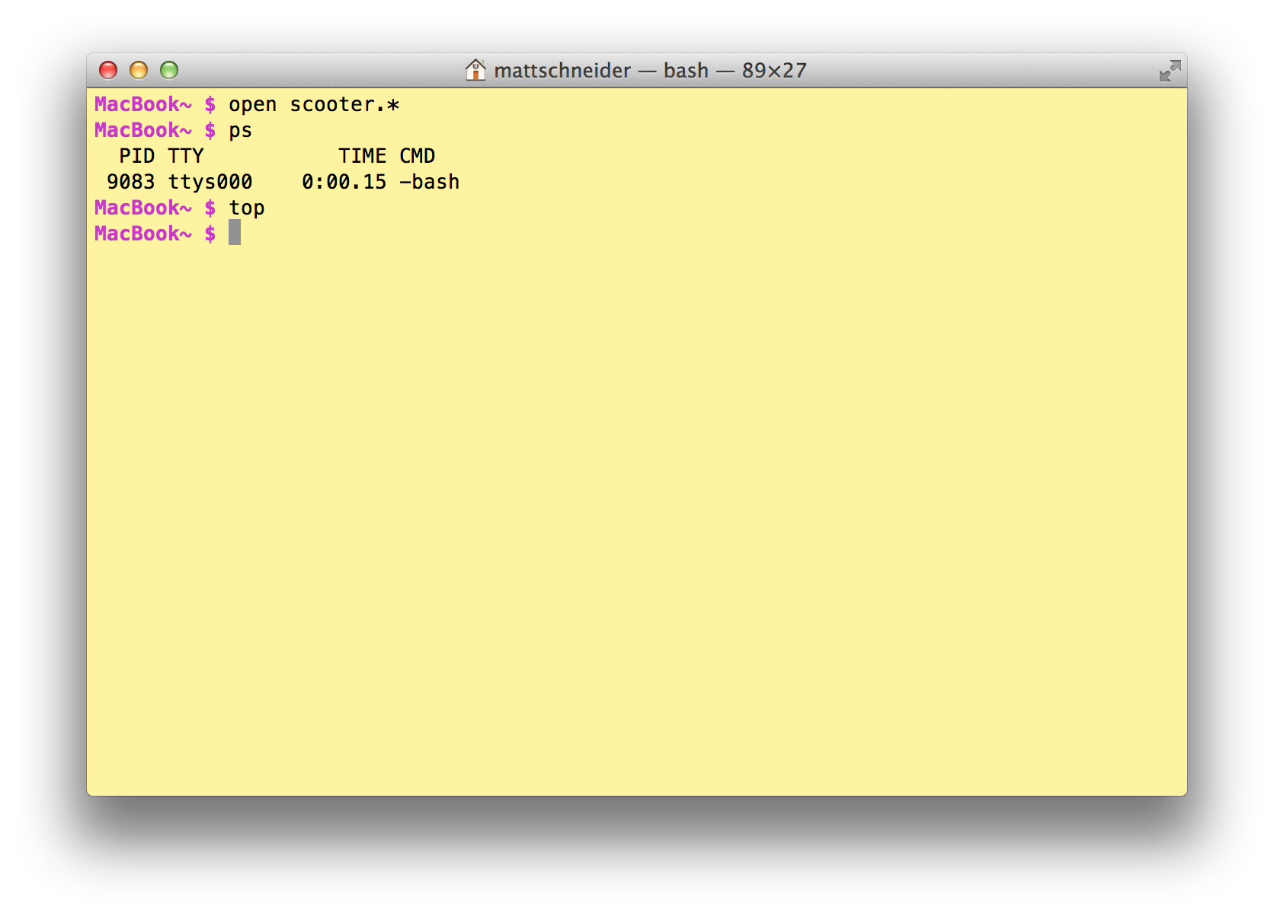
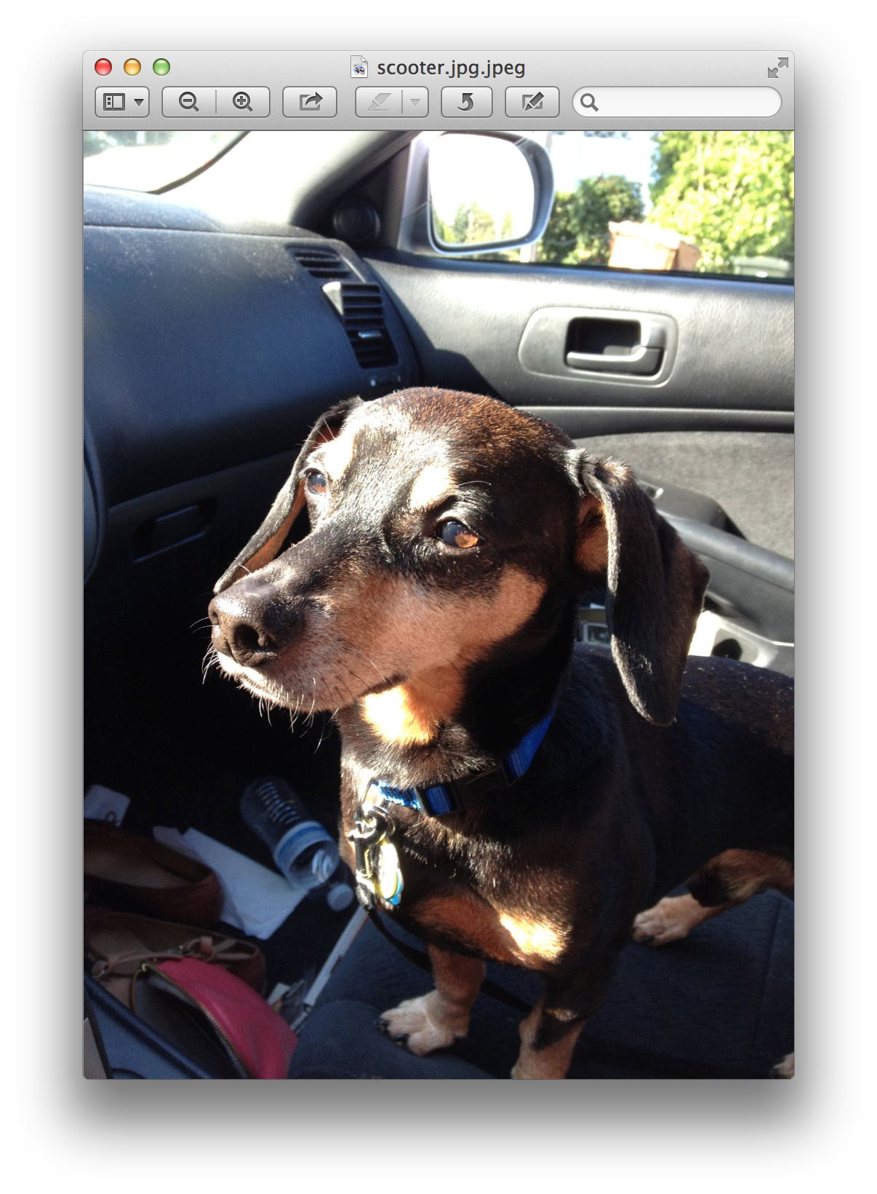

Slide 8

The fun stuff
say good job!
emacs
Esc X tetris
screencapture
Congratulate yourself!
Play tetris
takes screenshot

Slide 9
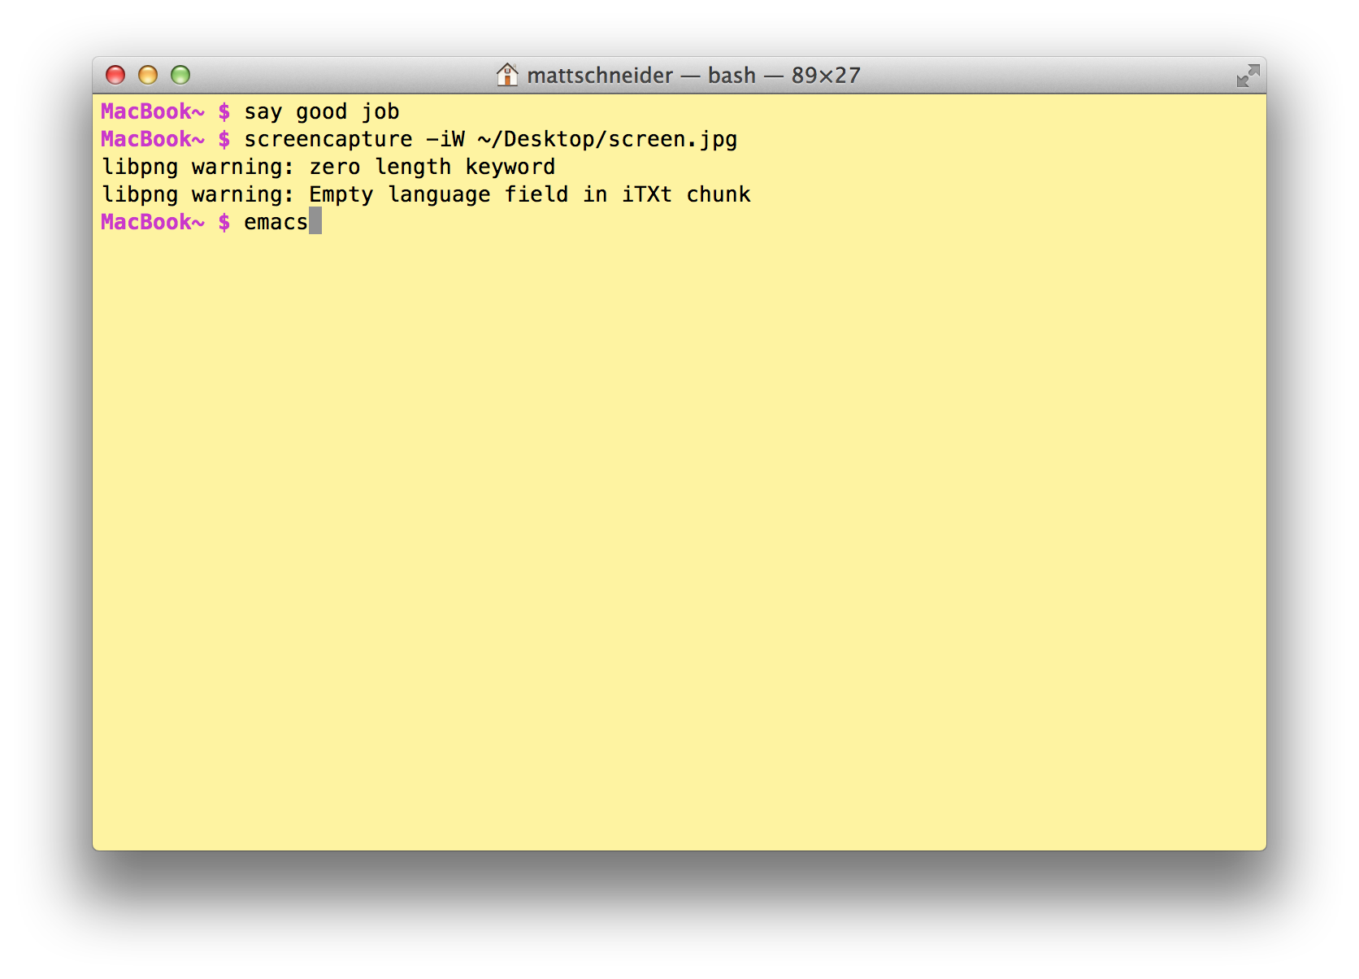
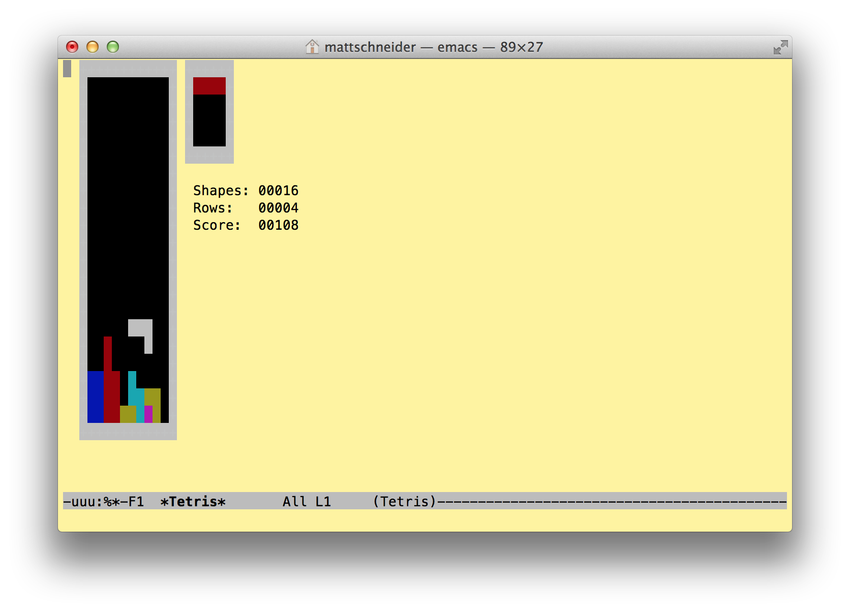

Slide 10
Customize your terminal prompt
edit .bash_profile to add the line: export PS1="prompt"
Here’s mine: export PS1="\[\e[1;35m\]MacBook\w $ \[\e[m\]"
You can choose to include the following in your prompt:
\d – Current date
\t – Current time
\h – Host name
\# – Command number
\u – User name
\W – Current working directory (ie: Desktop/)
\w – Current working directory, full path (ie: /Users/Admin/Desktop)

Slide 11

Thanks!
Contact me at:
schneider.matthew.b@gmail.com
https://github.com/MBSchneider
Sources:
http://mac.appstorm.net/how-to/utilities-how-to/how-to-use-terminal-the-basics/
http://mac.tutsplus.com/tutorials/terminal/10-terminal-commands-that-every-mac-user-should-know/
http://guides.macrumors.com/Terminal
http://www.wikihow.com/Customize-Your-Mac-Using-the-Terminal#Learn_how_to_use_the_Terminal
http://www.wikihow.com/Open-Applications-Using-Terminal-on-Mac
http://www.maclife.com/article/howtos/25_top_os_x_terminal_tips
http://www.macosxtips.co.uk/index_files/10-tips-for-using-mac-os-x-like-a-pro.php

